Slide 1


Human Population Genetics Workshop 2025
Genome-wide association studies

Slide 2
Contents
Genome-wide association studies
The What and The Why: Theory behind GWAS
The How: Basic steps to conducting a GWAS
Limitations of GWAS
Demonstration

Slide 3
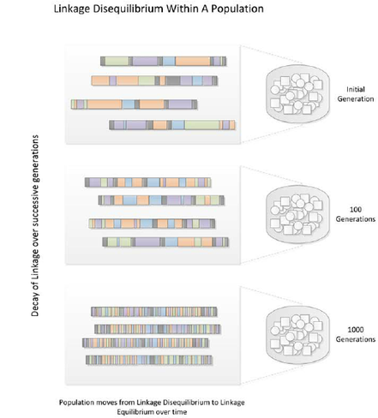
Theory before we start
Linkage disequilibrium
Linkage disequilibrium (LD) is the non-random association between alleles at separate but linked loci in a population (normally the result of the alleles lying within a common haplotype).
This means that these alleles are typically inherited together.

Slide 4
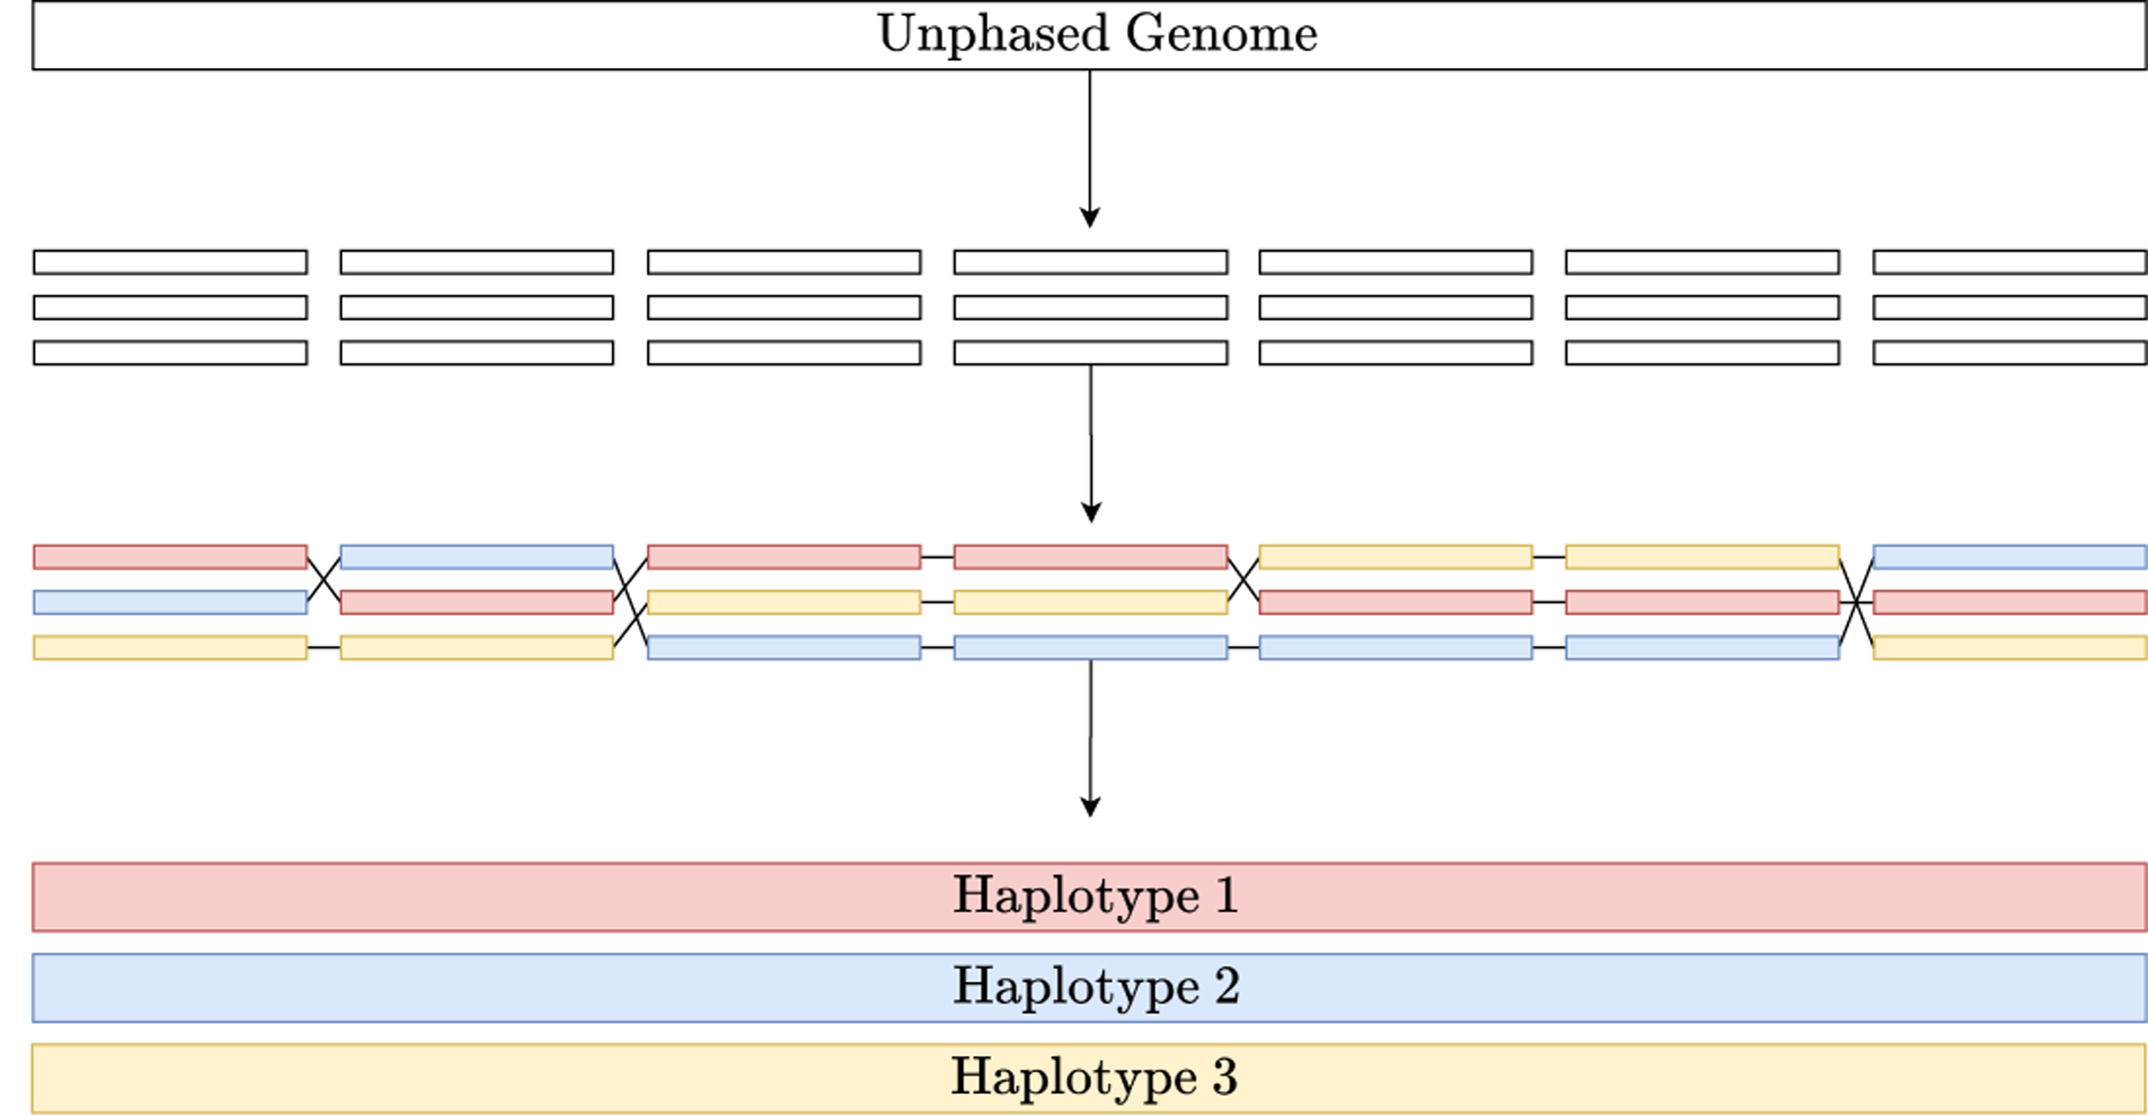
Theory before we start
Haplotypes
A haplotype is a series of alleles found at linked loci on a single chromosome.
Haplotype blocks are blocks of variants that are in LD with each other, but not with variants in adjacent blocks.
We can infer haplotypes computationally through phasing.

Slide 5
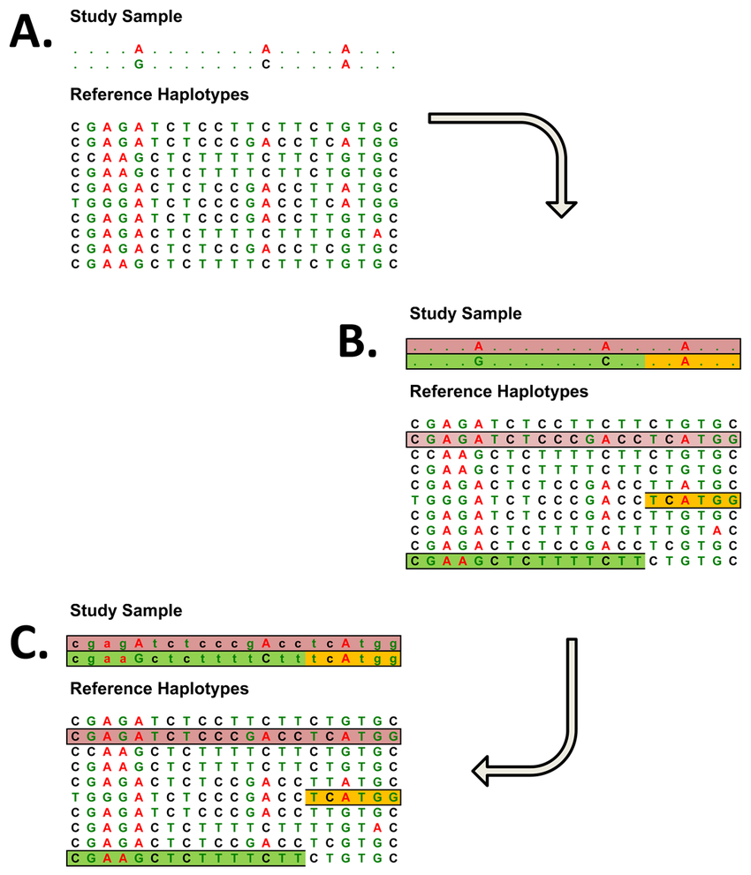
Theory before we start
Tagging SNPs
Tagging SNPs are specific SNPs single-nucleotide polymorphisms that can be used to identify haplotype blocks.
If we use tagging SNPs, we don’t have to genotype every SNP in a haplotype block – we can genotype a few SNPs and infer the untyped SNPs through imputation.

Slide 6
Genome-wide association studies
Definition
Genome-wide association studies (GWAS) are observational studies that involve comparing a genome-wide set of genetic variants (often in the form of millions of single nucleotide polymorphisms, SNPs) between groups of individuals with and without a particular trait or disease of interest.
It is a hypothesis free search for associations between genetic variants and a particular trait without any need for a prior understanding of the biology underlying the phenotype of interest.

Slide 7
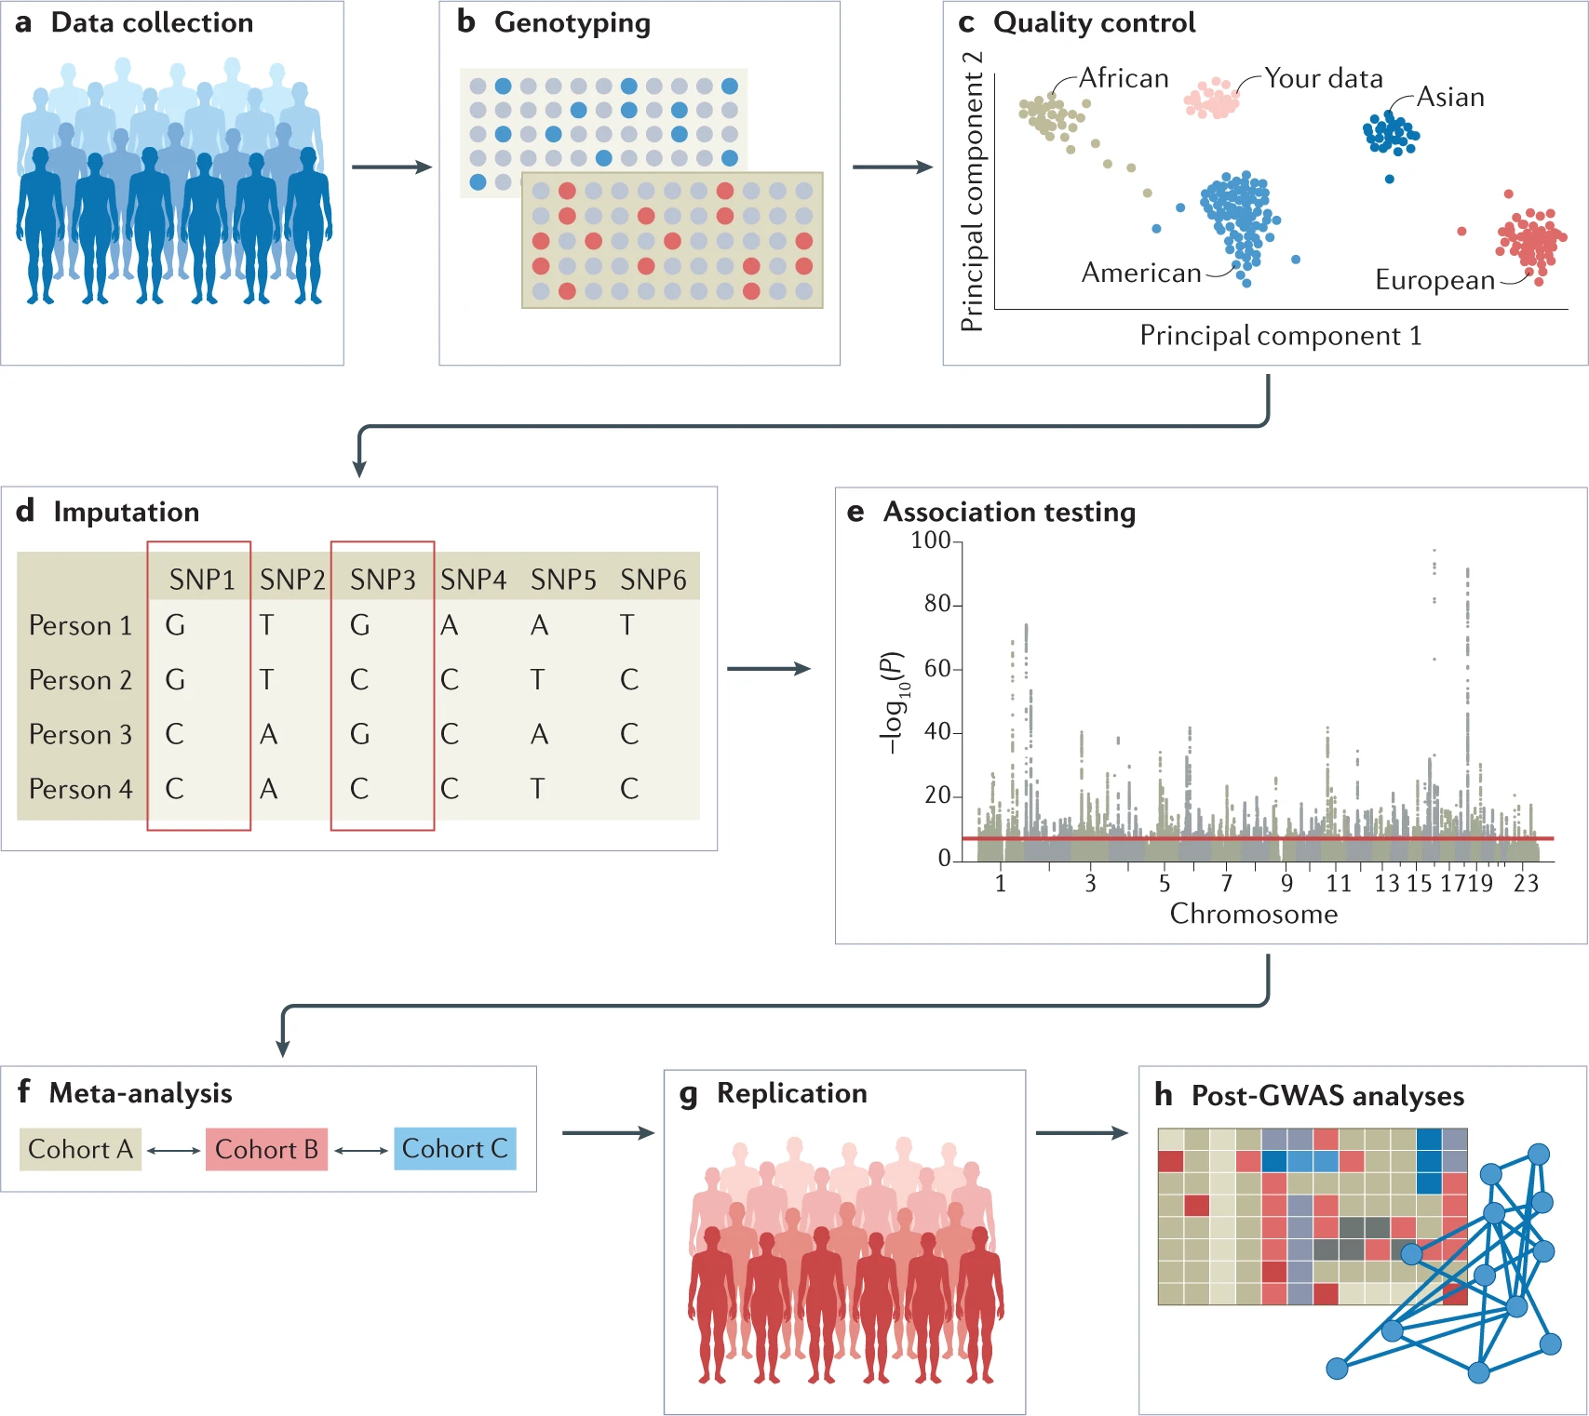

Genome-wide association studies

Slide 8
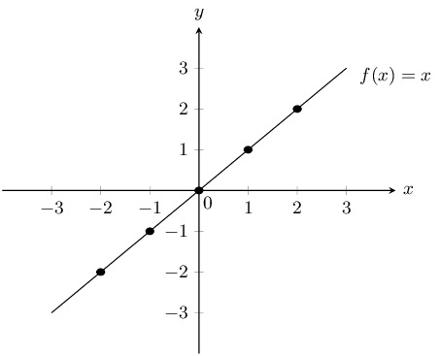
Theory behind GWASs
How do we find associations?
Grade 10 Maths
Regression models
A function that describes the relationship between a dependent variable and one or more independent variables.
y = mx + c

Slide 9
Theory behind GWASs
How do we find associations?
What is our outcome (the dependent variable)?
The trait/phenotype/disease under study.
Traits or phenotypes can be classified as binary or continuous.
The presence or absence of the trait.
The trait can have many different variations along a continuous spectrum.

Slide 10
Theory behind GWASs
How do we find associations?
What is/are our independent variables?
The genotype.
Individuals can be homozygous for the reference allele, heterozygous or homozygous for the alternate allele.
But there are other independent variables at play in genetics!
Age
Sex
Ancestry
Covariates

Slide 11
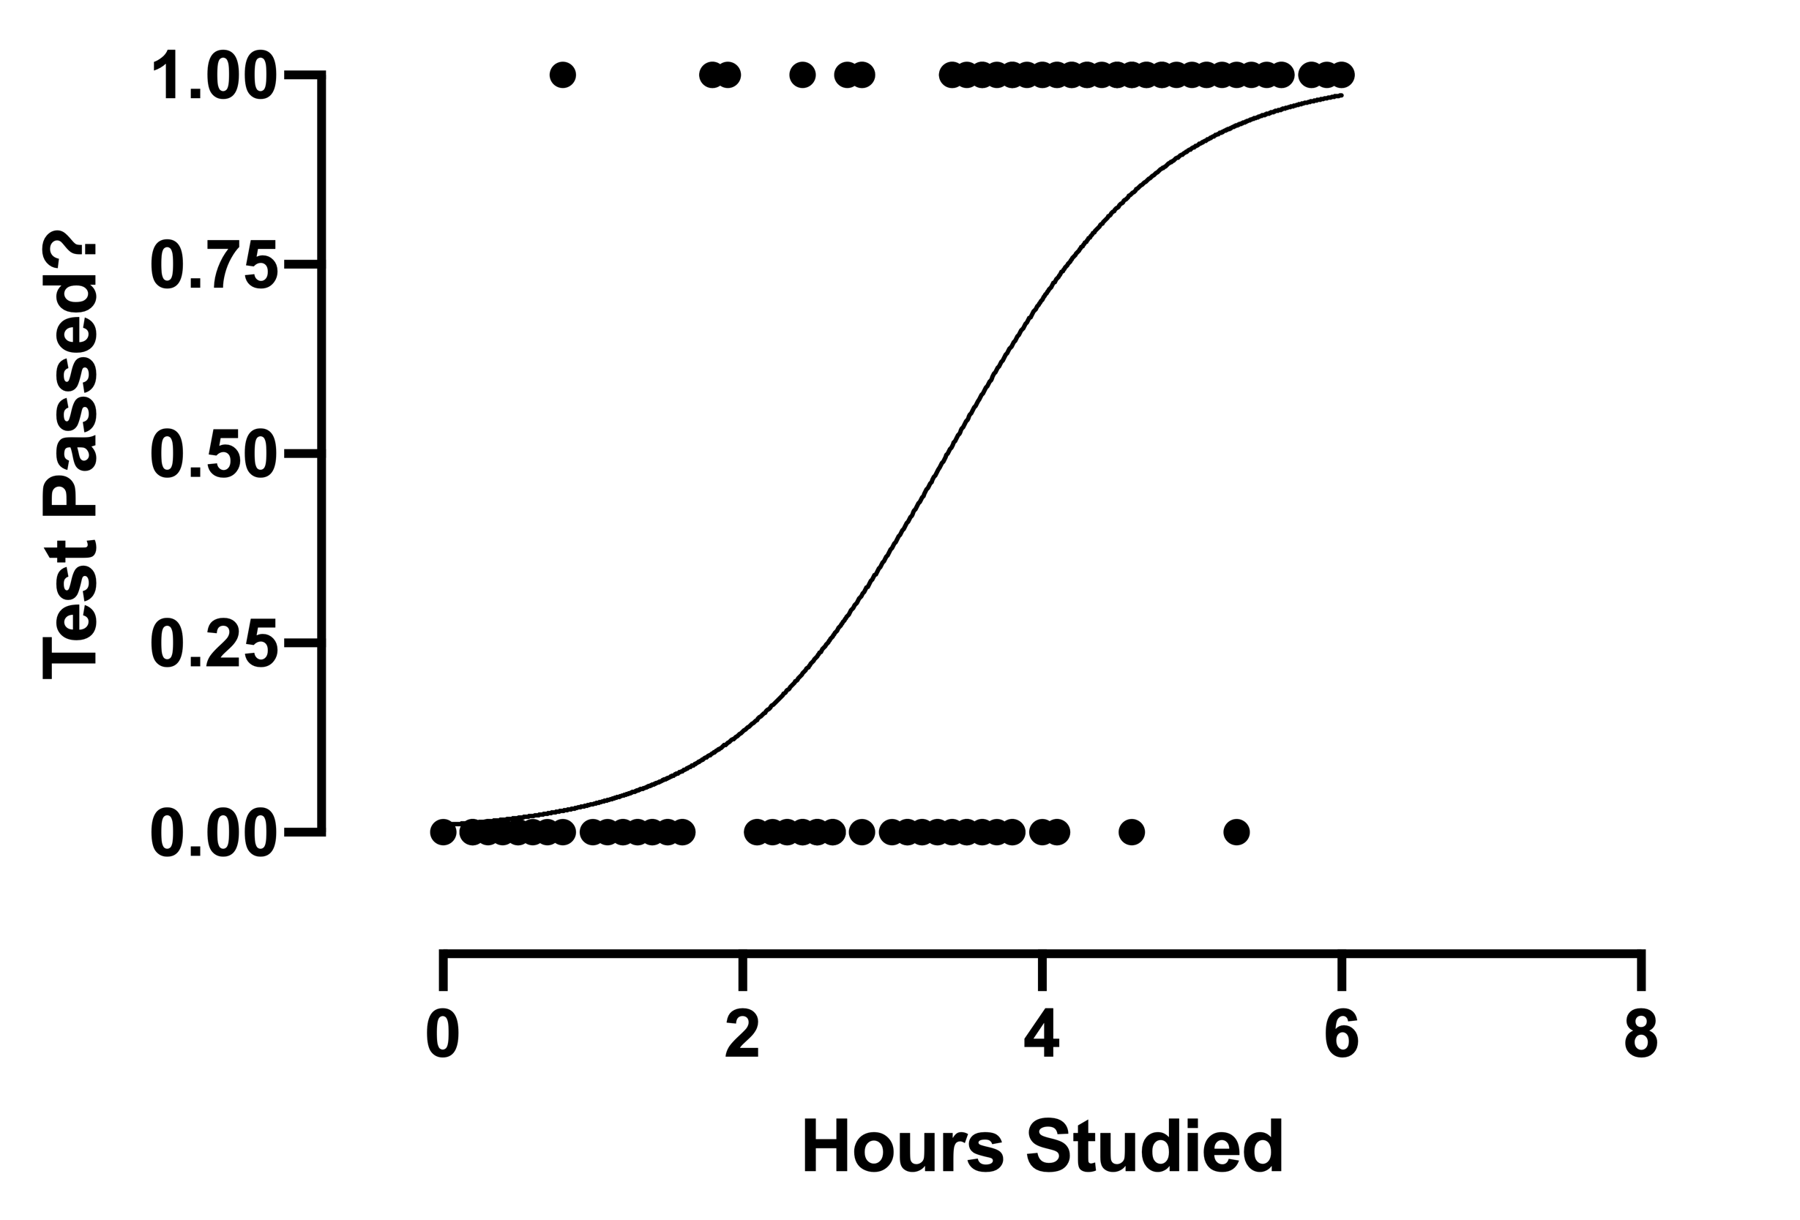
Theory behind GWASs
Binary traits
Trait
The outcome is coded as zero for the absence of the trait and one for the presence of the trait.
Use logistic regression models.
Genetic variants are coded based on the number of “risk” alleles [0, 1 or 2].
1
0
SNP
GG
[0]
GT
[1]
TT
[2]

Slide 12
Theory behind GWASs
Continuous traits
Trait
The outcome is coded as a number based on the variation observed.
Use linear regression models.
Genetic variants are coded based on the number of “risk” alleles [0, 1 or 2].
6
5
4
3
2
1
0
SNP
GG
[0]
GT
[1]
TT
[2]

Slide 13

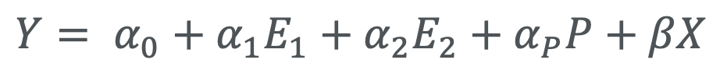
Theory behind GWASs
Models and their meanings
The intercept
Reference/baseline risk
Log-Odds ratio
Outcome
[0 or 1]
$$Y= α_{0}+α_{1}E_{1}+α_{2}E_{2}+α_{P}P+βX$$
Risk alleles
[0, 1 or 2]
Covariates
Age, sex and ancestry proportions and their corresponding effect sizes
Notes:
Intercept: This provides the reference or baseline risk for the outcome before considering any additional genetic or environmental factors.

Slide 14
Running a GWAS - Demonstration

Slide 15
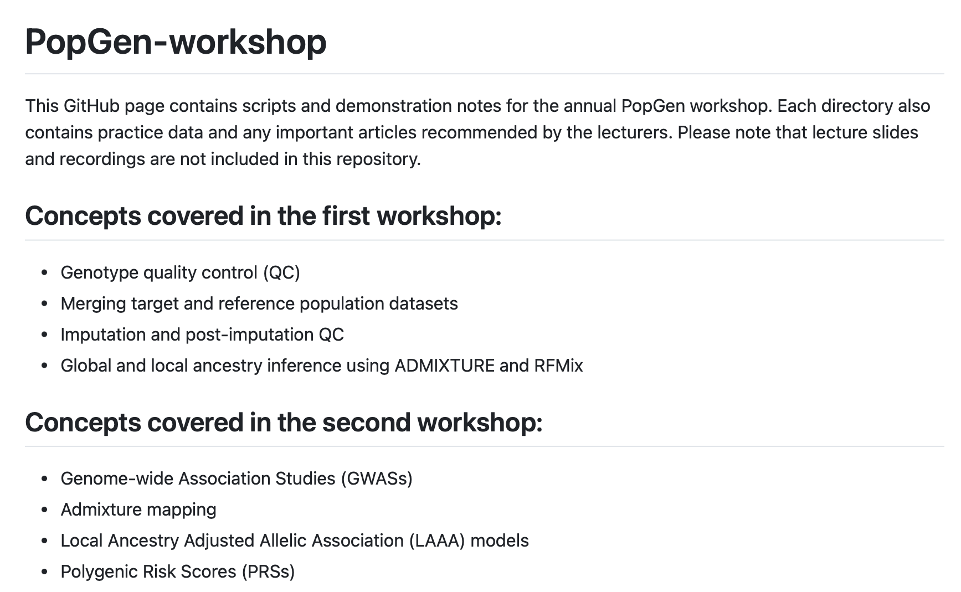
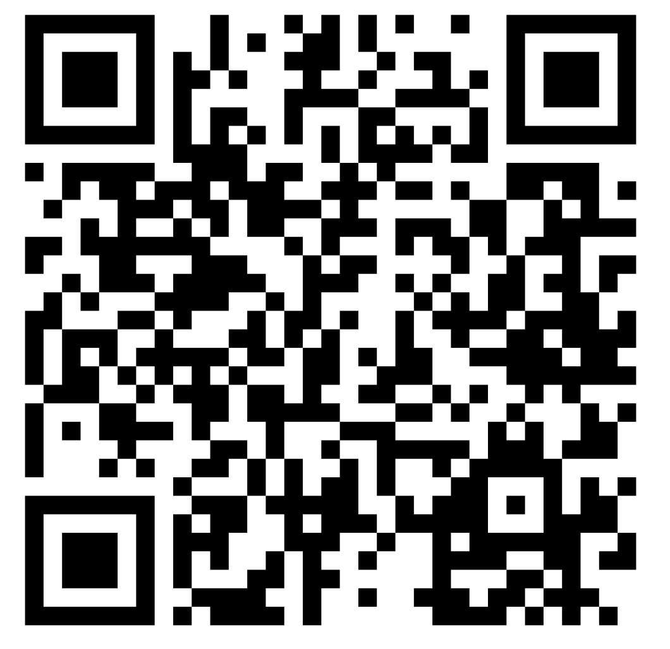
PopGen-workshop GitHub page
https://github.com/TBHostGenetics/PopGen-workshop

Slide 16
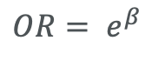
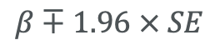
Theory behind GWASs
Reporting the results
$$OR= e^{β}$$
Log-Odds ratio
Odds ratio
CHROM | POS | REF | ALT | ALT Freq | Beta | 95% CI | OR | SE | P-value
Confidence intervals
Standard error
$$β∓1.96 × SE$$

Slide 17
Theory behind GWASs
Odds ratios
Describe the relative odds of the outcome occurring in individuals with the alternate allele versus individuals with the reference allele.
OR = 1: There is no association between the genetic variant and the trait. The odds of the outcome are the same regardless of the allele (alternate or reference).
OR > 1: Increased risk associated with the alternate allele.
OR < 1: The alternate allele is associated with a reduced risk or a protective effect.
Odds that a case has the alternate allele
OR =
Odds that a control has the alternate allele

Slide 18

Theory behind GWASs
P-values
The probability of observing the association between SNP and outcome of interest by chance, assuming the null hypothesis is true.
Null hypothesis: there is no association between the genetic variant and outcome.

Slide 19
Theory behind GWASs
P-values
The multiple testing burden
The increased likelihood of obtaining false-positive results when conducting a very large number of statistical tests.
Since GWAS involves testing each genetic variant (often millions of SNPs) for association with the trait, the vast number of tests increases the probability of observing significant associations purely by chance.
If the conventional p-value threshold of 0.05 were used, 5% of SNPs would show significant results by chance alone.

Slide 20
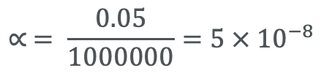
Theory behind GWASs
P-values
The multiple testing burden
In GWASs, we use a more stringent p-value threshold to reduce the chance of false positives while preserving true associations.
There are several multiple testing correction methods. The most used method is Bonferroni correction. It adjusts the significance threshold by dividing the standard alpha level (typically 0.05) by the total number of tests performed.
Example: For a GWAS with 1 million SNPs…
$$∝ = \frac{0.05}{1000000}=5 × {10}^{−8}$$

Slide 21
Theory behind GWASs
P-values
The multiple testing burden
While stringent thresholds effectively reduce false positives, they also increase the risk of false negatives (missing true associations) by making it harder for weak but real associations to reach significance.
To counteract this, GWAS studies often require very large sample sizes to achieve enough power to detect true associations despite the strict significance threshold.
Power: the probability of correctly identifying a true association between a SNP and the outcome of interest.

Slide 22
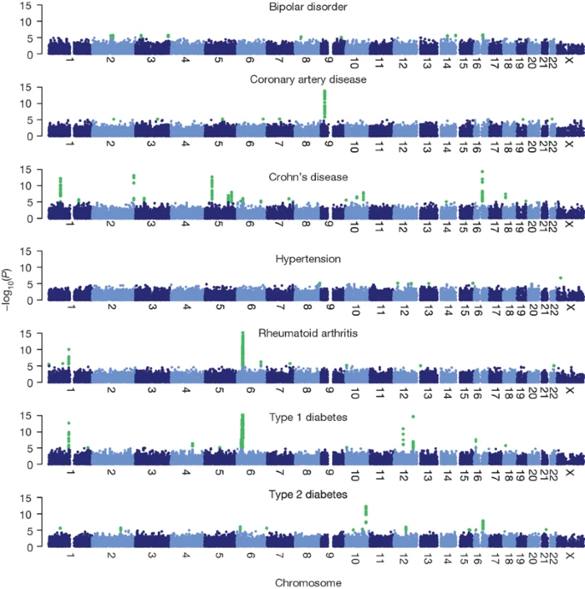
Theory behind GWASs
Reporting the results
The distribution of p-values (as –log₁₀ p) for the association of each SNP with the disease is shown in ”Manhattan plots.”
QQ-plots are used to compare the observed p-values to the expected p-values under the null hypothesis.

Slide 23
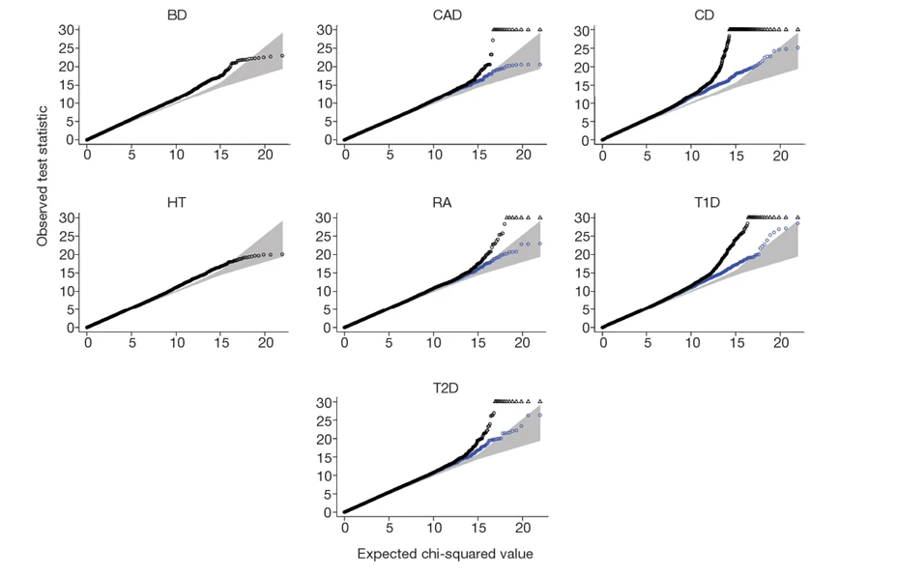
Theory behind GWASs

Slide 24
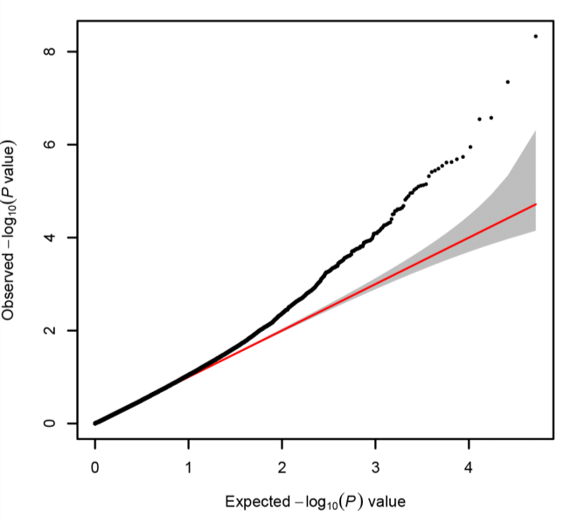
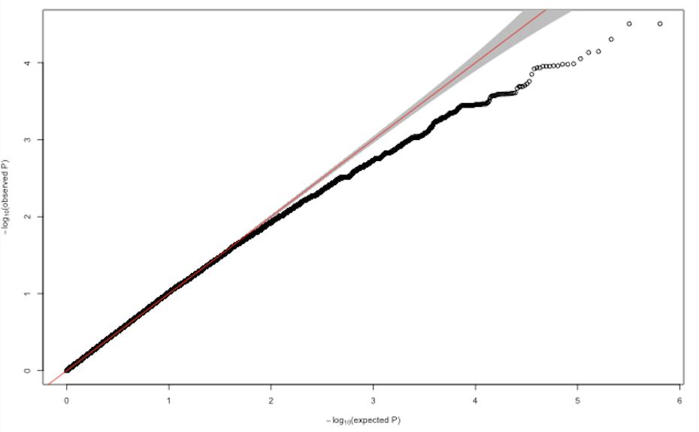
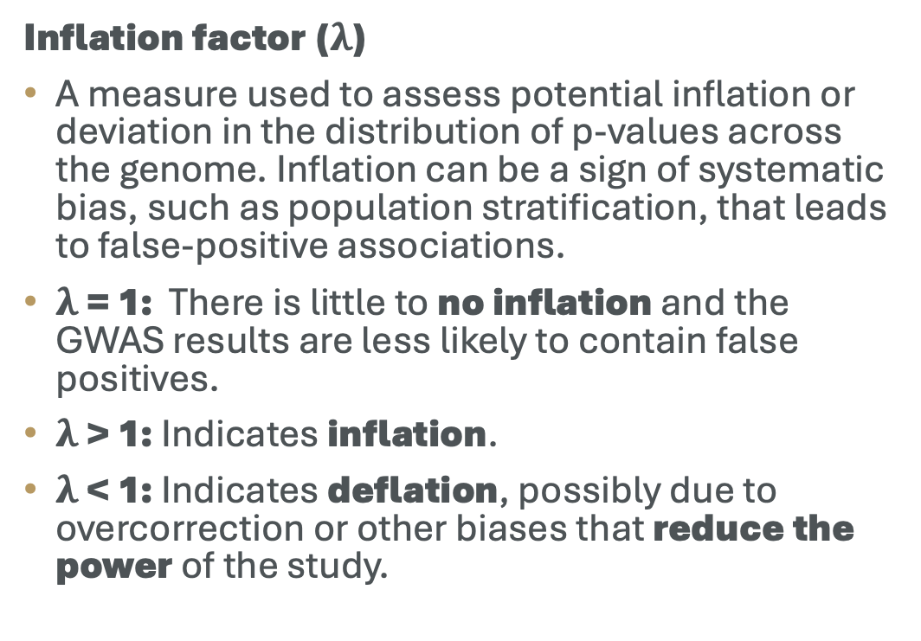
Theory behind GWASs
Reporting the results
Inflation factor ($λ$)
A measure used to assess potential inflation or deviation in the distribution of p-values across the genome. Inflation can be a sign of systematic bias, such as population stratification, that leads to false-positive associations.
$λ$ = 1: There is little to no inflation and the GWAS results are less likely to contain false positives.
$λ$ > 1: Indicates inflation.
$λ$ < 1: Indicates deflation, possibly due to overcorrection or other biases that reduce the power of the study.

Slide 25
Reporting the results - Demonstration

Slide 26
Recommended reading
GWAS
Uffelmann, E., Huang, Q.Q., Munung, N.S. et al. “Genome-wide association studies.” Nat Rev Methods Primers 1, 59 (2021).

Slide 27

Thank you
Enkosi
Dankie
Photo by Stefan Els
Notes:
Cover & End Slide Option
Replace the background image: Right-click on the slide, then choose Format Background and select Picture or texture fill. Select a new picture of your choice.
Remember to add an image attribution for e.g., Photo by Stefan Els.

